Slide 1

Project Title: Image Transformation Using Python & Numpy
COMPUTER SCIENCE & MATHEMATICS

Slide 2
Name: Atharva S Gadad
Name: Adarsh Kumar
Team Members
SRN : PES1UC20CS088
SRN: PES2UC20CS016
Name:
Ayush Kumar Gupta
Name:
Chetan Reddy
SRN : PES1UC20CS095
SRN: : PES1UC20CS109

Slide 3
Project Objective Image manipulation using numpy arrays to show the use of Linear Algebra in these techniques

Slide 4
TABLE OF CONTENTS
Edges Detection
Upscale
01
03
Grayscale
Downscale
02
04
Perform edge detection on given image
Upscale image
Convert image to grayscale
Downscale image
To be Continued….

Slide 5
TABLE OF CONTENTS
Flip
Rotate
05
06
Invert Colour
07
Flips the image
Rotate image by given angle
Contrast
08
Invert colors of the image
Increasing the contrast of the Image

Slide 6
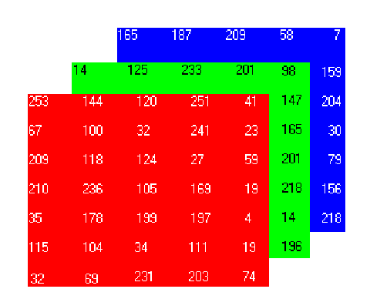
SOME BASICS

Slide 7
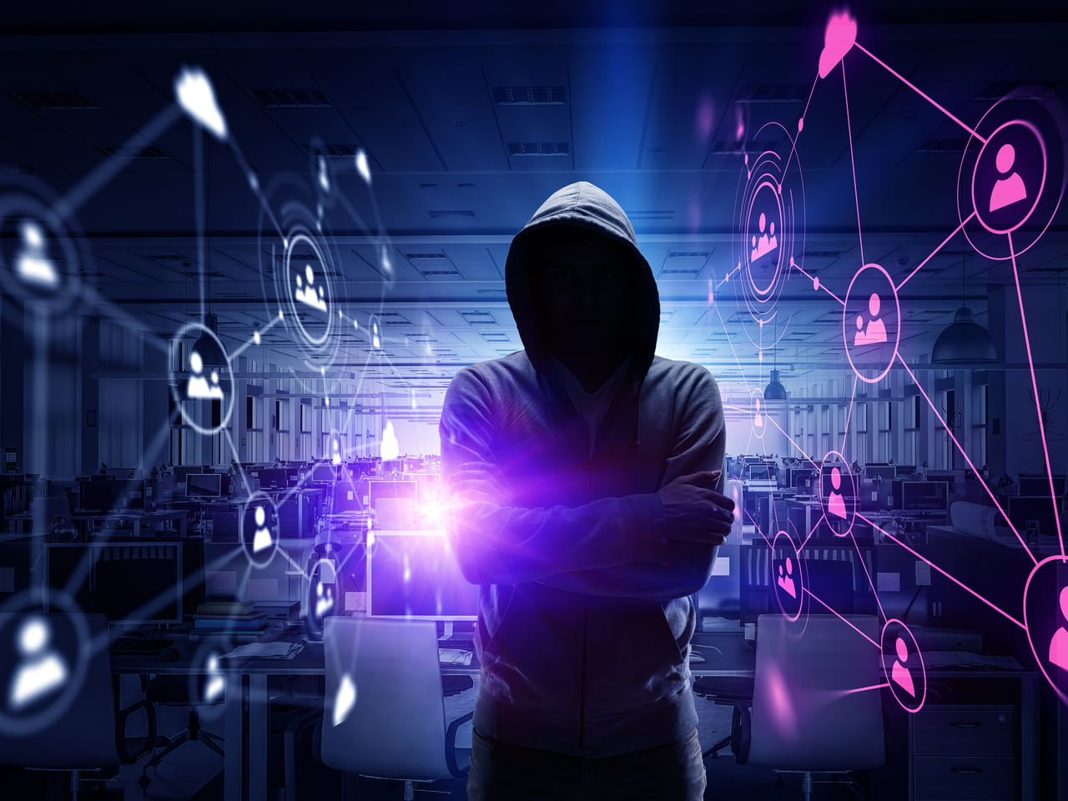
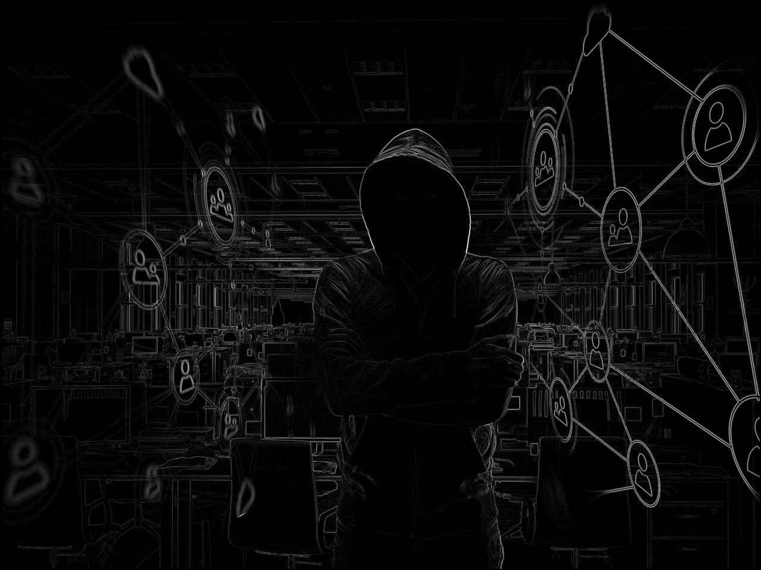
Original Img
Edges Detection
After Operation

Slide 8
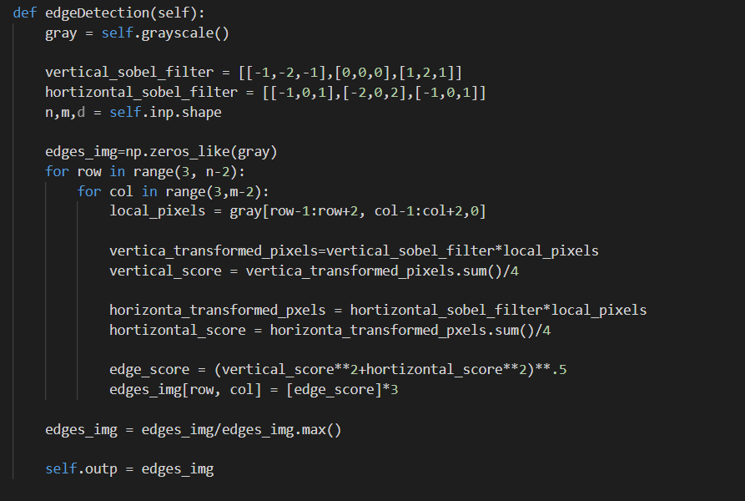
CODE

Slide 9
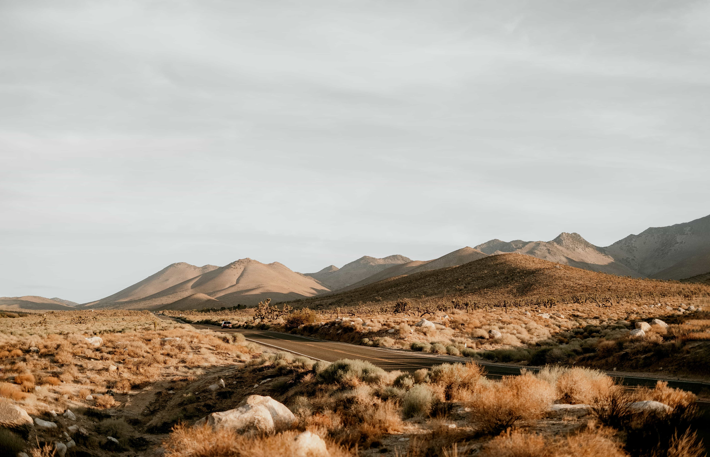
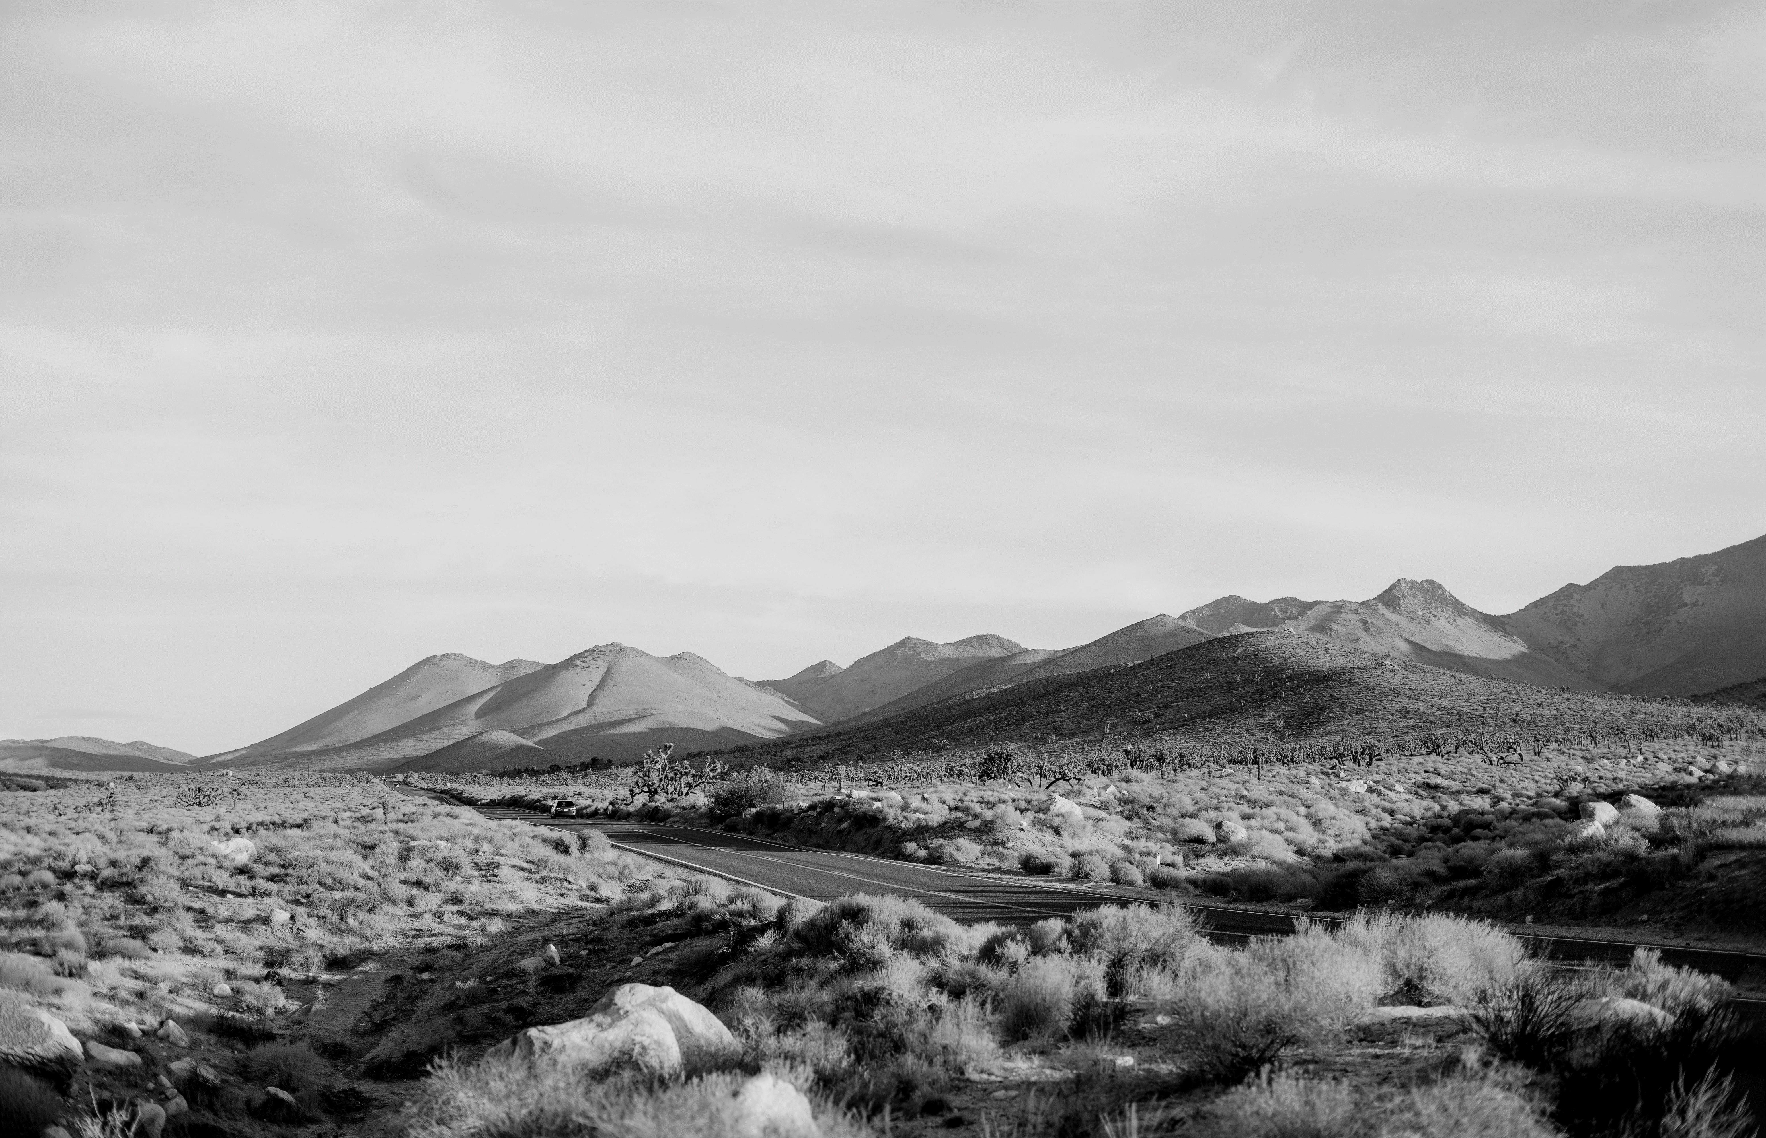
Original Img
Grayscale
After Operation

Slide 10
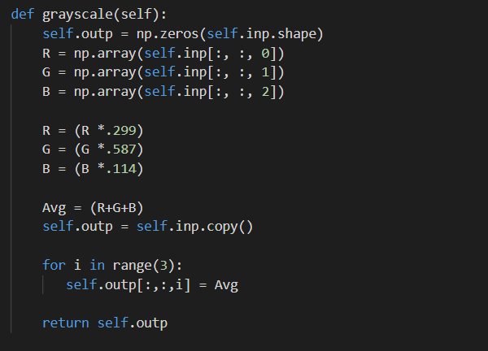
CODE

Slide 11


Original Img
Upscale
After Operation

Slide 12
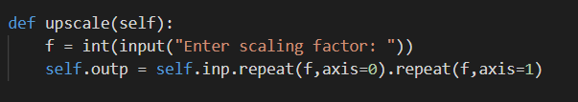
CODE

Slide 13
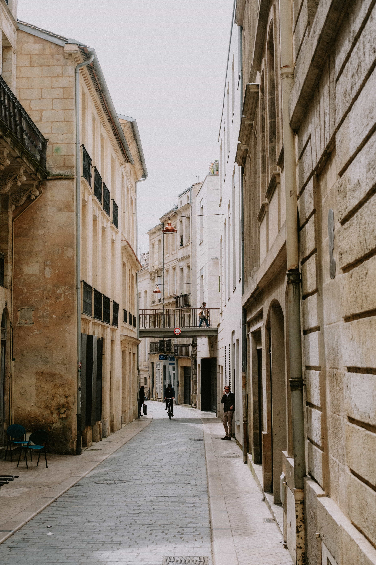
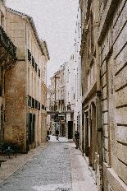
Original Img
Downscale
After Operation

Slide 14
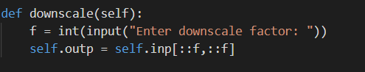
CODE

Slide 15
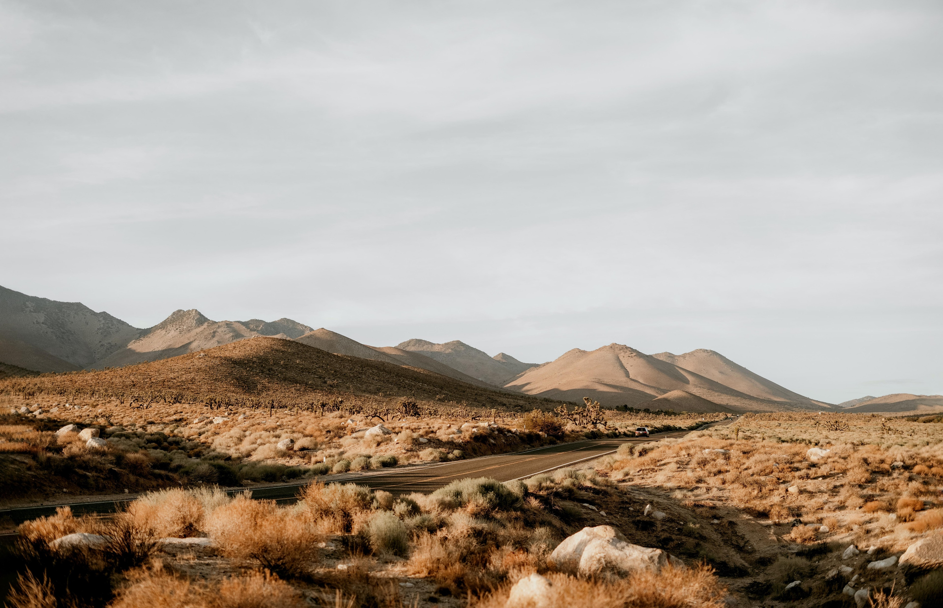
Original Img
Flip
After Operation

Slide 16
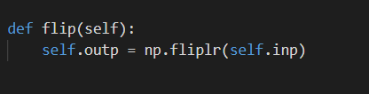
CODE

Slide 17
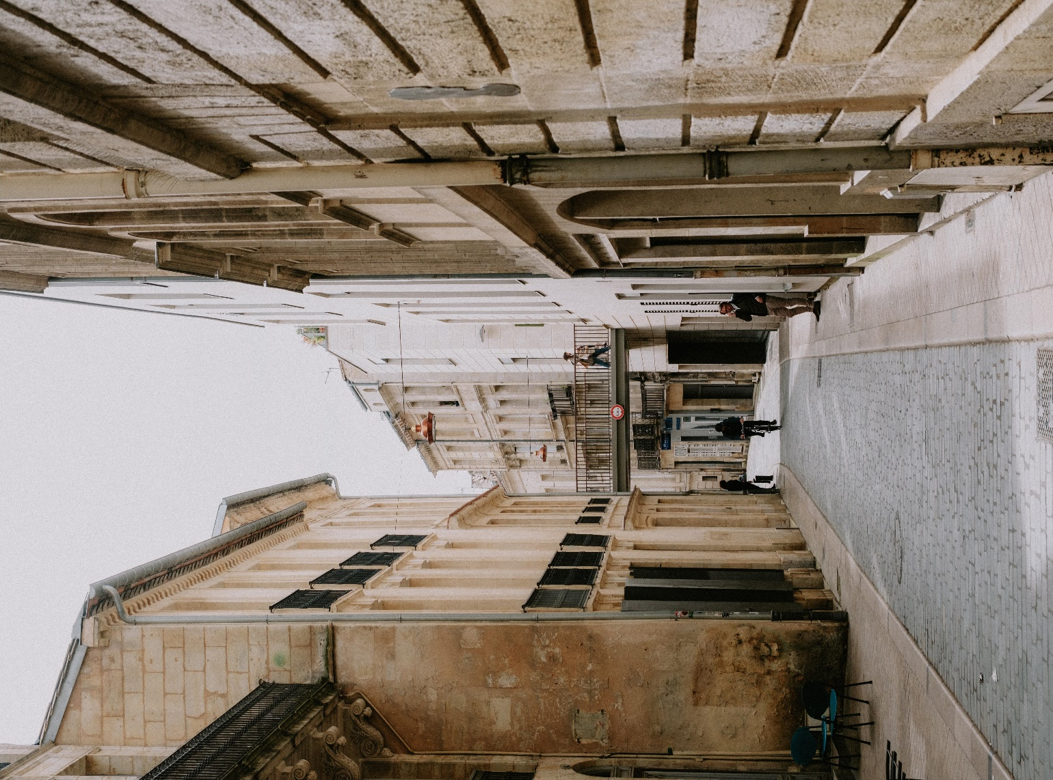
Original Img
Rotate
After Operation

Slide 18
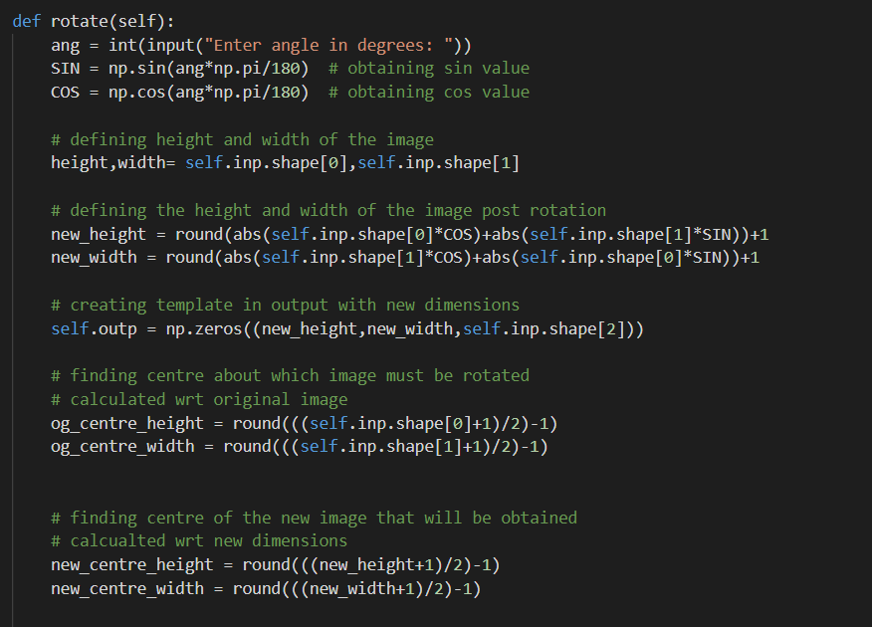
CODE

Slide 19
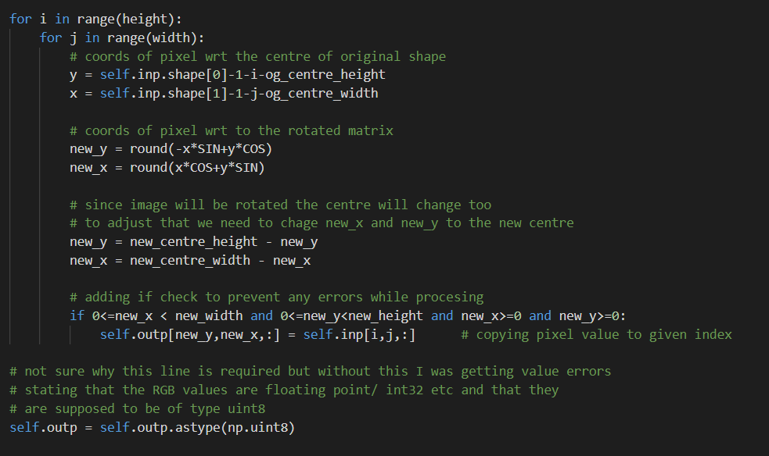
CODE

Slide 20
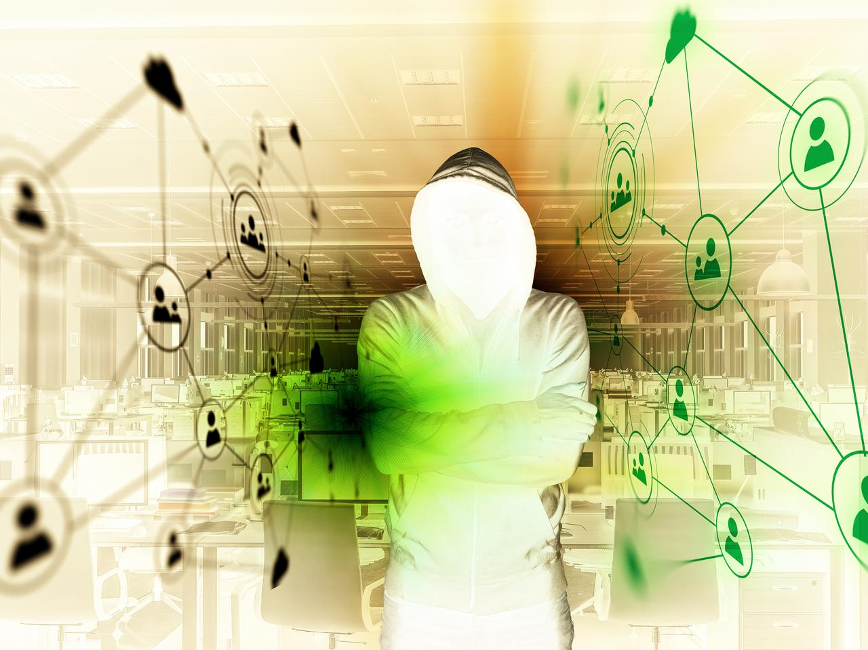
Original Img
Invert Colour
After Operation

Slide 21
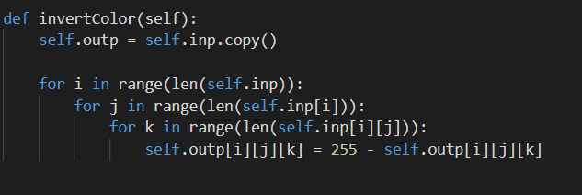
CODE

Slide 22
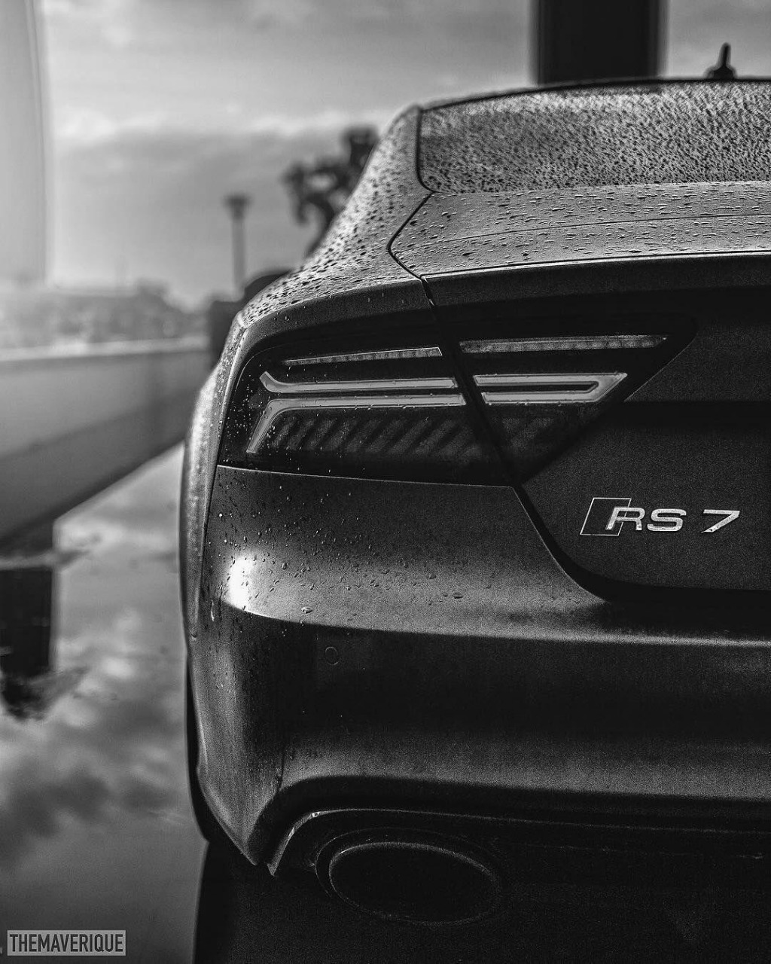

Original Img
Contrast
After Operation

Slide 23
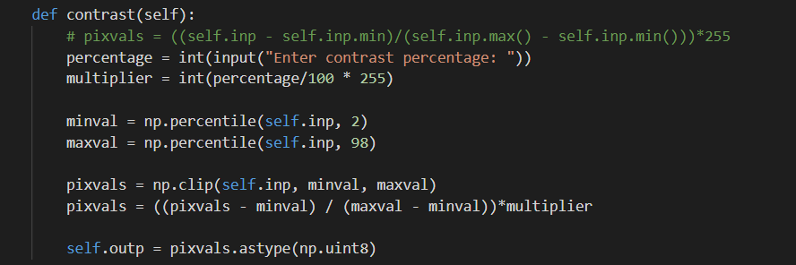
CODE

Slide 24
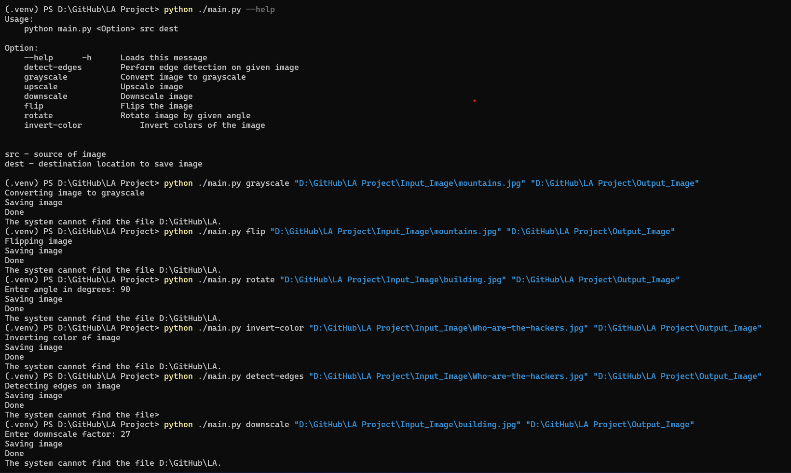
HOW TO RUN

Slide 25
REFERENCES
https://www.projectrhea.org/rhea/index.php/An_Implementation_of_Sobel_Edge_Detection#:~:text=in%20today%27s%20technology.-,The% 20Math%20Behind%20the%20Algorithm,be%20processed%20 separately%20as%20well.
www.researchgate.net%2Ffigure%2FA-three-dimensional-RGB-matrix-Each-layer-of-the-matrix-is-a-two-dimensional-matrix_fig6_267210444&psig=AOvVaw1LIthLfc6s7GwWqpcoaDfm&ust=1650330800817000&source=images&cd=vfe&ved=0CAkQjRxqFwoTCOiM7by3nPcCFQAAAAAdAAAAABAO
https://www.youtube.com/watch?v=PiErX7Y-ho0

Slide 26
REFERENCES
https://www.tutorialspoint.com/dip/grayscale_to_rgb_conversion.htm#:~:text=You%20just%20have%20to%20take,Its%20done%20in%20this%20way.
https://e2eml.school/images_to_numbers.html
https://www.kdnuggets.com/2019/12/convert-rgb-image-grayscale.html

Slide 27
Applications
The modules can be used for creation of Image Editing Tools.
Edge detection is used for controlling drone movement, detection of cracks in machinery, fractures in bones
Greyscale is used in edge-detection and image inversion.

Slide 28
Thank you

